Slide 1
Towards flexible endoscopic suturing: prototyping the CYCLOPS system for advanced surgical techniques
MRes. Medical Robotics and Image-Guided Intervention 2017-2018
Siddharth Agarwal
Hyunggi Chang
Laura Ros Freixedes
Chara Giannoudi
Ya-Yen Tsai
Supervisors: Dr. George Mylonas, Alexandros Kogkas, Fernando Avila, Joric Oude Vrielink

Slide 2
Overview & Motivation

Slide 3
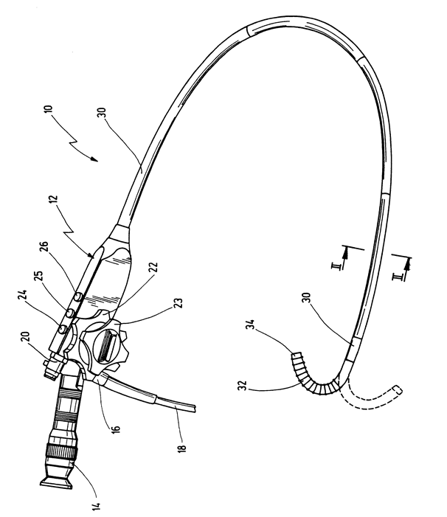
NOES – Natural Orifice Endoscopic Surgery
Minimally invasive surgery (MIS)
Reduced trauma, reduced complications
Reduced pain, quicker recovery
NOES
Performed endoscopically
Does not necessarily require dedicated theatre
Good for early intraluminal lesions
Endoscopes offer 4 Degrees of Freedom
Endoscope biopsy channel offers 2 Degrees of Freedom

Slide 4
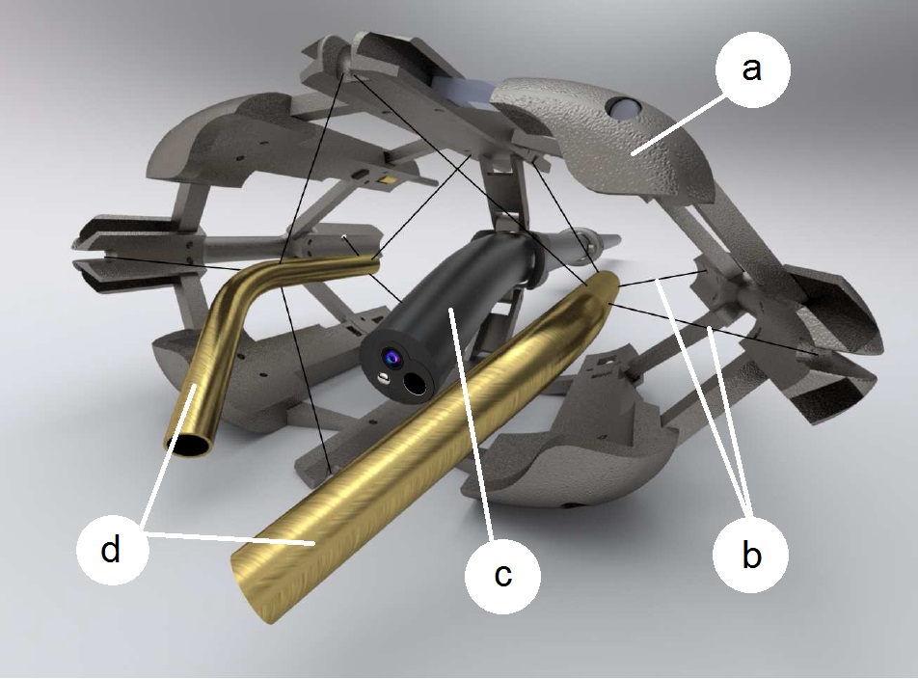
CYCLOPS Surgical System
The CYCLOPS surgical system is a low-cost add-on to any available endoscope to give the operator bimanual dexterity to perform complex surgical tasks
Off-the-shelf instruments pass through overtube
5 Degrees of Freedom per overtube
Cable driven parallel mechanisms allow for:
High traction forces (up to 65N)
Large adjustable workspace
High controllability and resolution
Deployable scaffold
Network of tendons
Endoscope
Rigid hollow over-tubes (curved for this task)

Slide 5
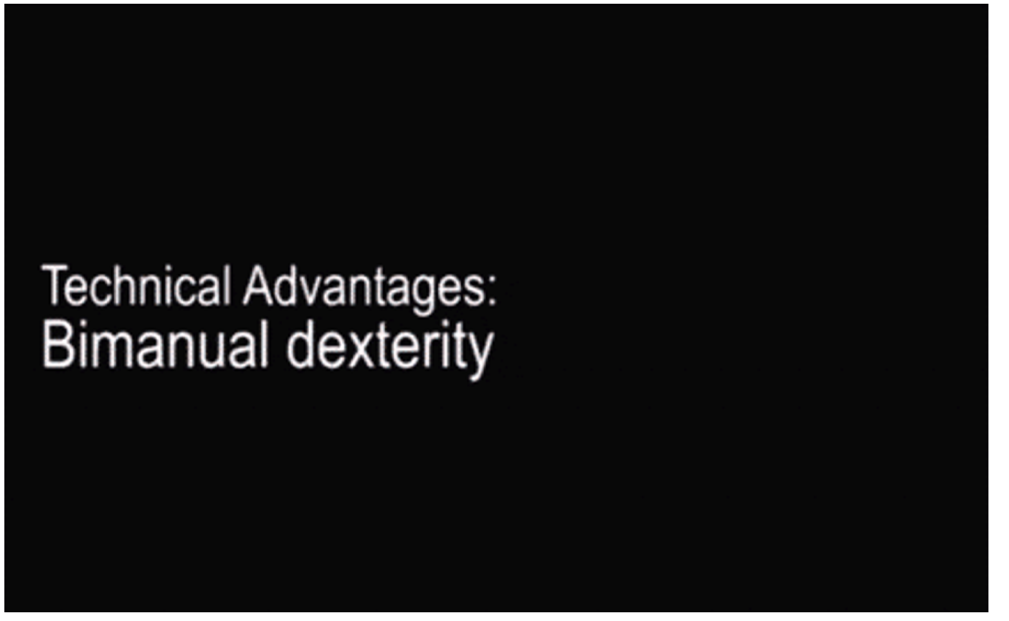
CYCLOPS Surgical System

Slide 6
CYCLOPS Adjustment

Slide 7
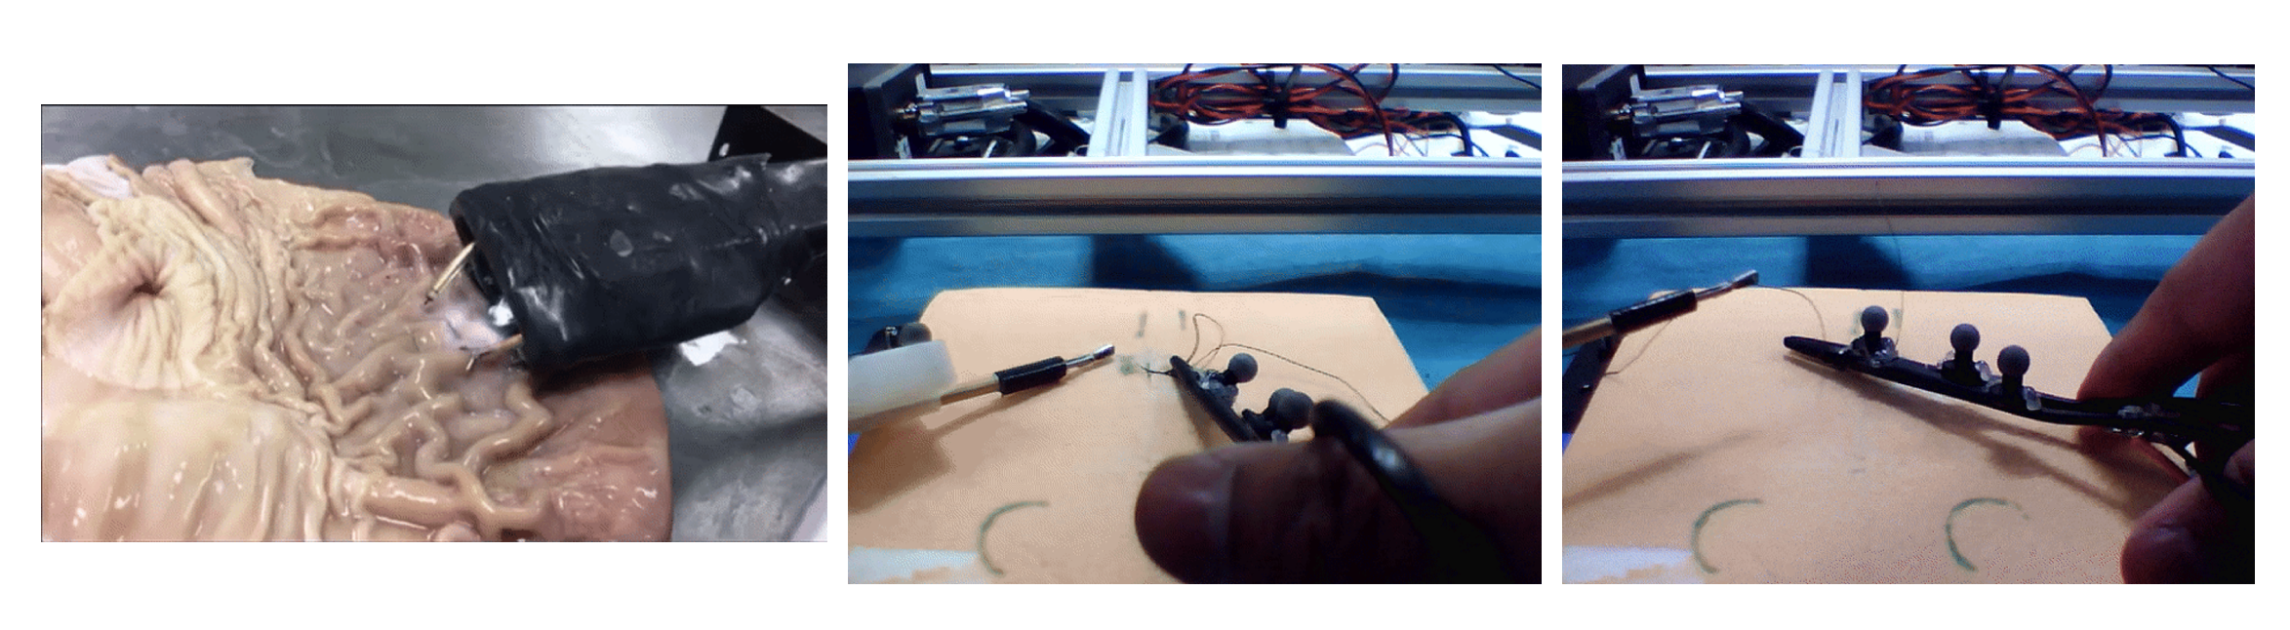
ESD vs Bimanual Suturing

Slide 8
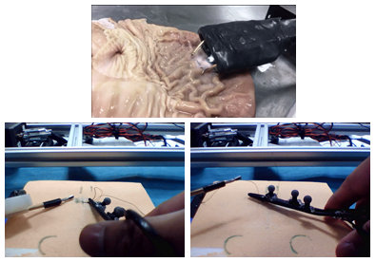
ESD vs Bimanual Suturing
ESD
Retract
Cut
Bimanual Suturing
Needle driving
Knot tying
Benchmark for all surgical systems
Requires 6 DoF – translates well to other tasks

Slide 9
Project Aims
Adjust the CYCLOPS surgical system for suturing
Needle driving
Knot Tying
Collect natural suturing hand motions
Data analysis
Position data
Force data
Optimisation algorithm
Optimise CYCLOPS workspace for the given task-space
Obtain optimal parameters regarding the tendons, feeding points and overtubes

Slide 10
Methodology

Slide 11
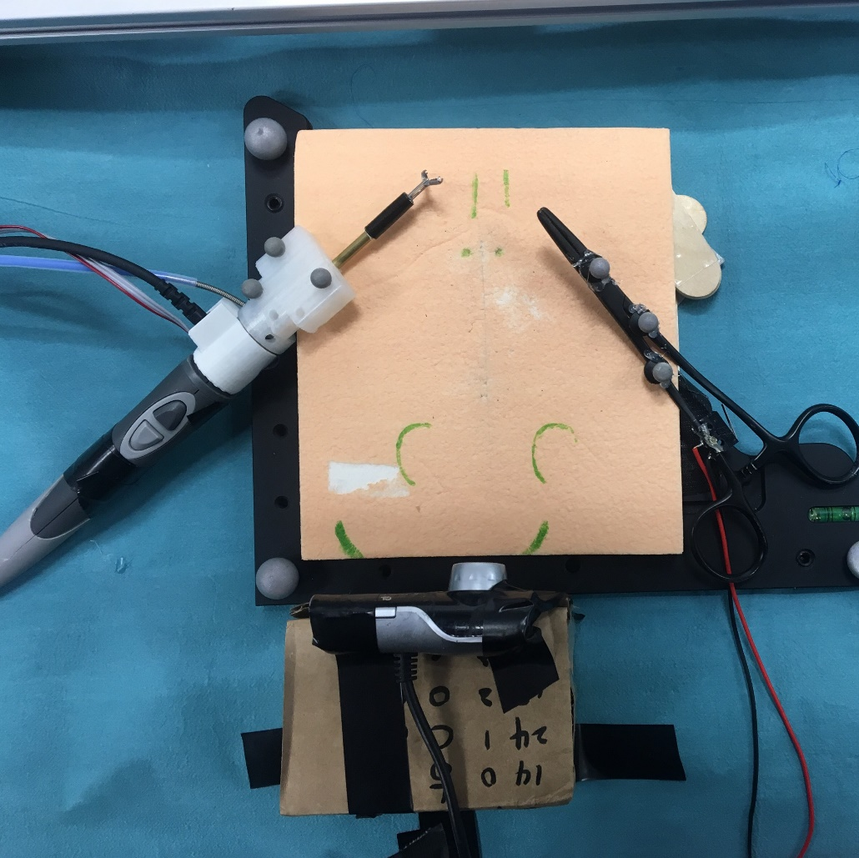
Data Collection
3 separate tests:
Suturing Test: Make 1 simple interrupted suture
Position data of both hands
Left hand force data (knot-tying)
Suture Quality Test: Using left hand only, applying force to the knot to validate the suture quality
Left hand force data
Force Test: Using right hand only, measuring force during needle insertion phase. Loadcell is placed underneath the suture pad.
Right hand force data

Slide 12
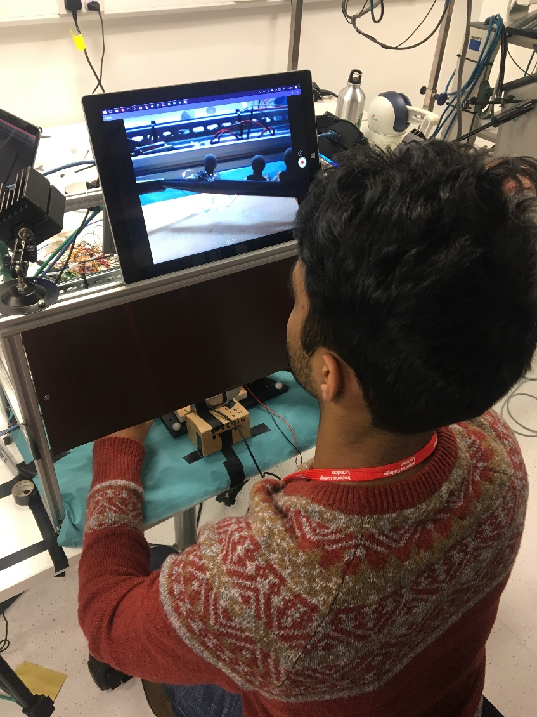
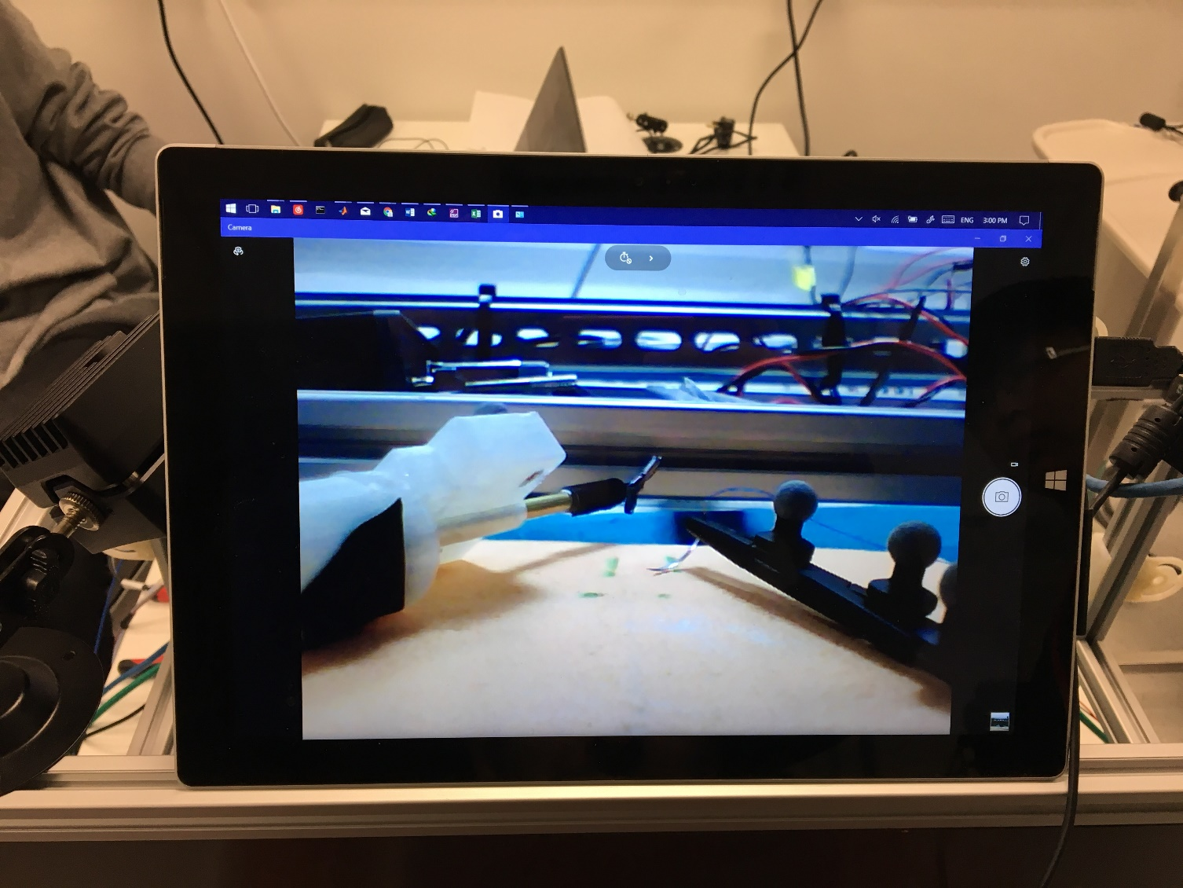
Data Collection

Slide 13
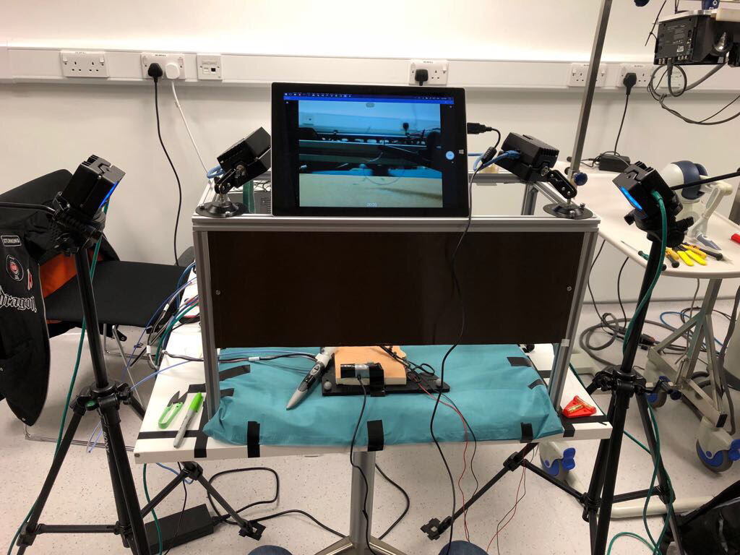
Data Collection Rig
Workspace frame & opaque screen
Webcam & Monitor
Hand-held right-hand needle driver
Left-hand grasper with a loadcell
4 Optitrack Prime IR cameras
Optical markers
An Arduino controller
An actuator module
Suturing pad

Slide 14
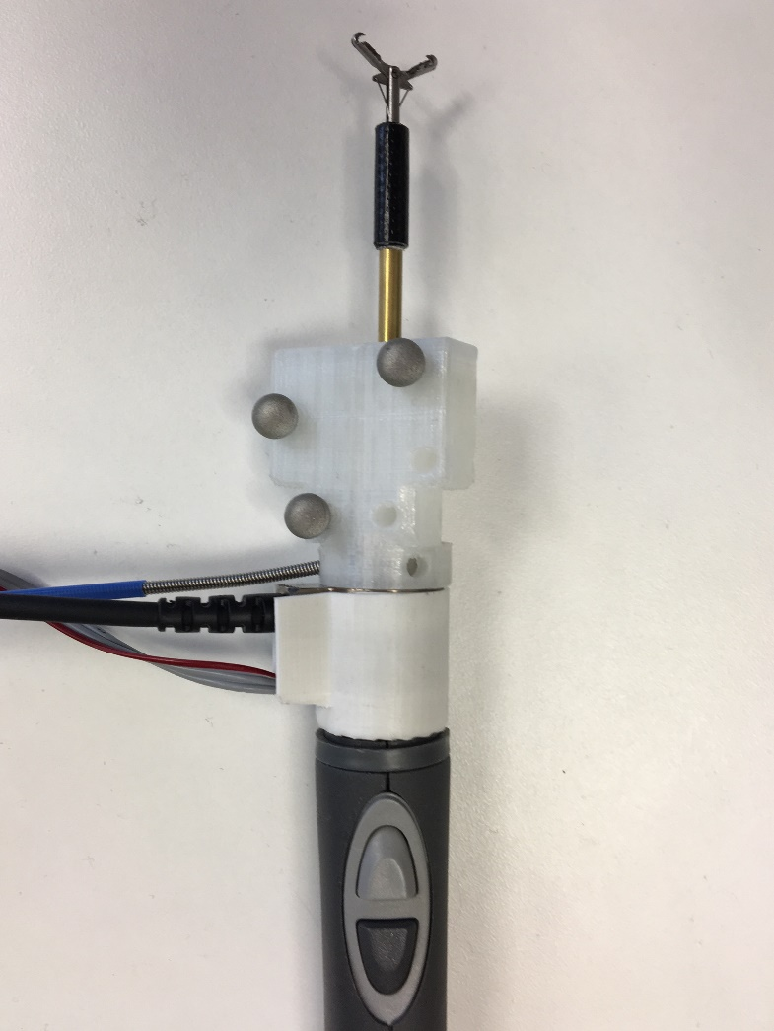
Left-hand Tool
Endoscopic grasper
3 optical markers to track position
6 DoF loadcell to track force data

Slide 15
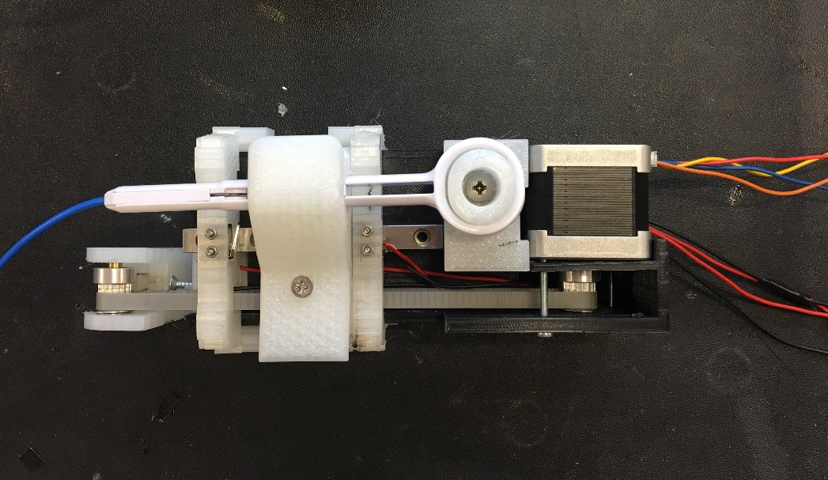
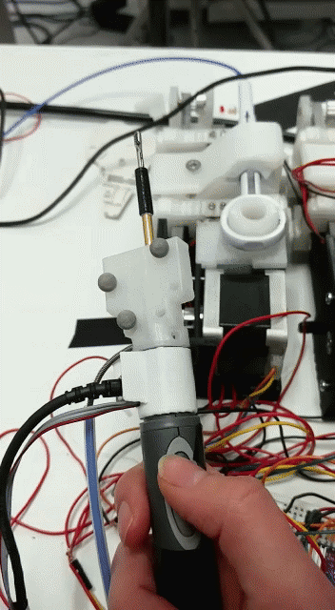
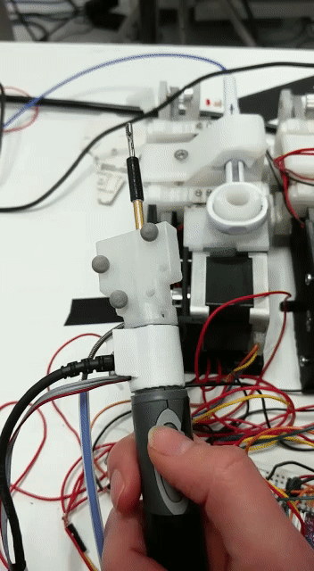
Actuation
Actuator:
Motor control of the left-hand tool
Switches at the ends to register gripper states

Slide 16
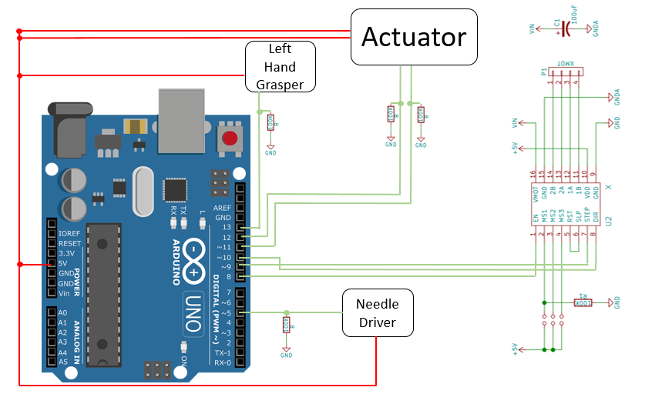
Actuation
Components:
Actuator
Breadboard
Arduino UNO
Motor driver
Power supply
Motor Driver

Slide 17
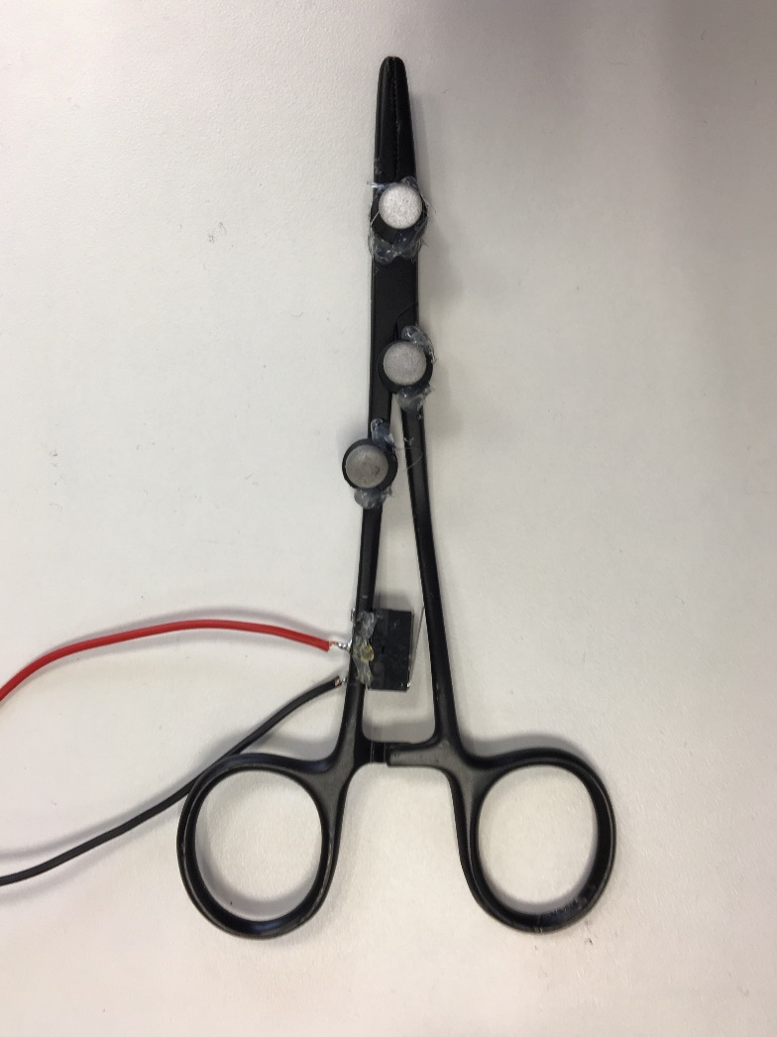
Right-hand Tool
Handheld needle driver
3 optical markers to track position data
Switch to track gripper state
Spray painted black to eliminate interference

Slide 18
Camera Configuration
2 cameras on the frame
2 cameras on tripods outside the frame
Focus match

Slide 19
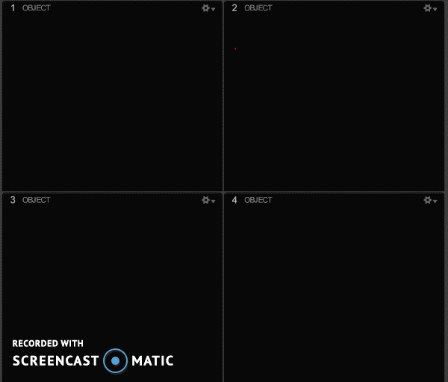
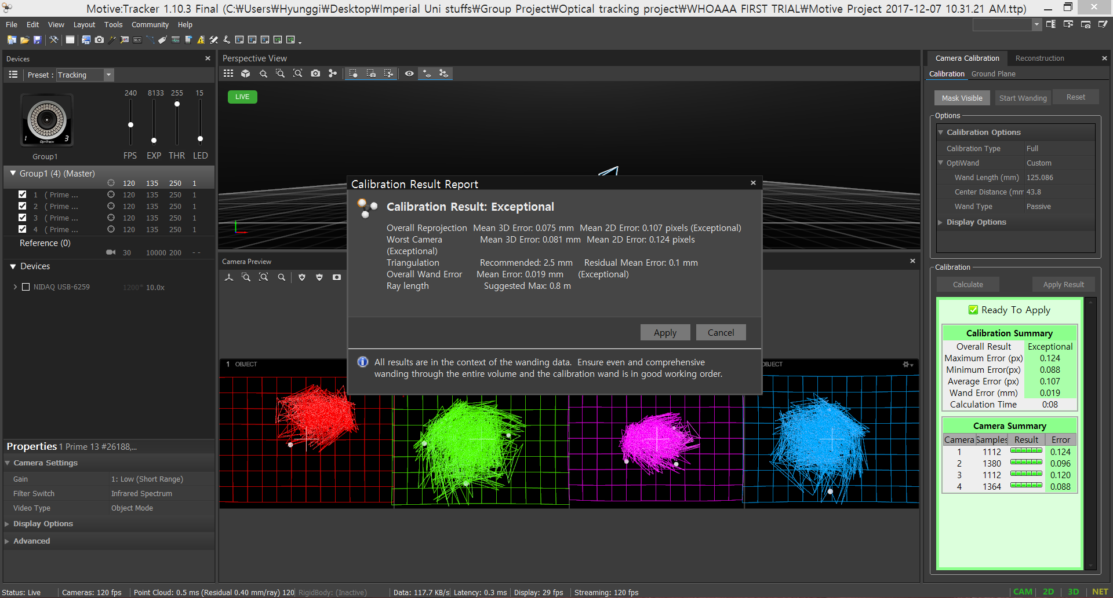
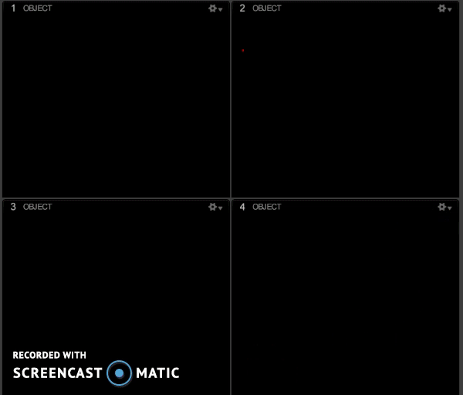
Camera Calibration
Cameras set to have clear focus and good IR exposure prior to calibration
Calibrate the cameras by registering wand movement. This establishes 3D capture volume.
Accepted calibration result: Excellent/ Exceptional (mean error <0.100mm). Any other calibration qualities (i.e. poor, fair, good, great) are rejected.

Slide 20
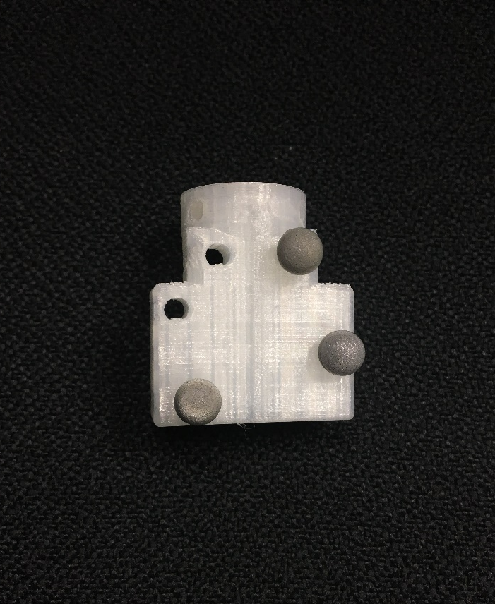
Optical Markers Configuration
Designed and 3D printed a flat optical marker base
3 optical markers
Large distance between markers - Allows rotation registration

Slide 21
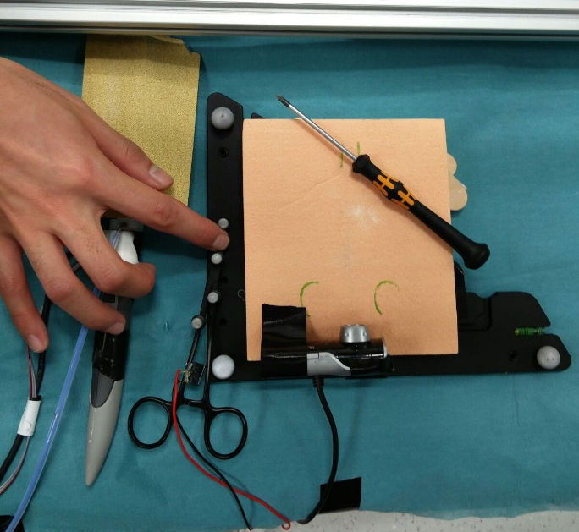
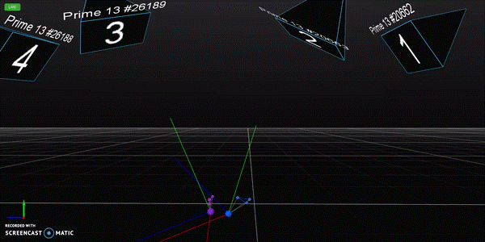
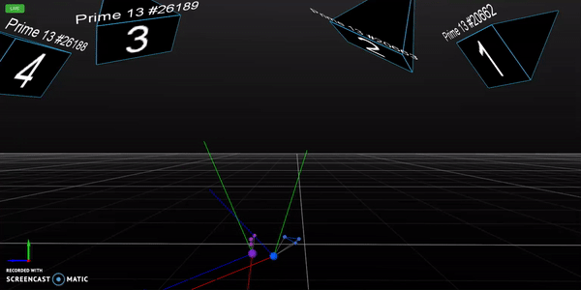
Tool calibration
Global coordinate established using the ground L-frame.
Assign a rigid body on the marker positions
Align the rigid body to one axis of global coordinate by aligning surfaces.
Compute rotation required for a correct local coordinate.
Translate the rigid body to the tool-tip
Check position and rotation registration is continuous

Slide 22
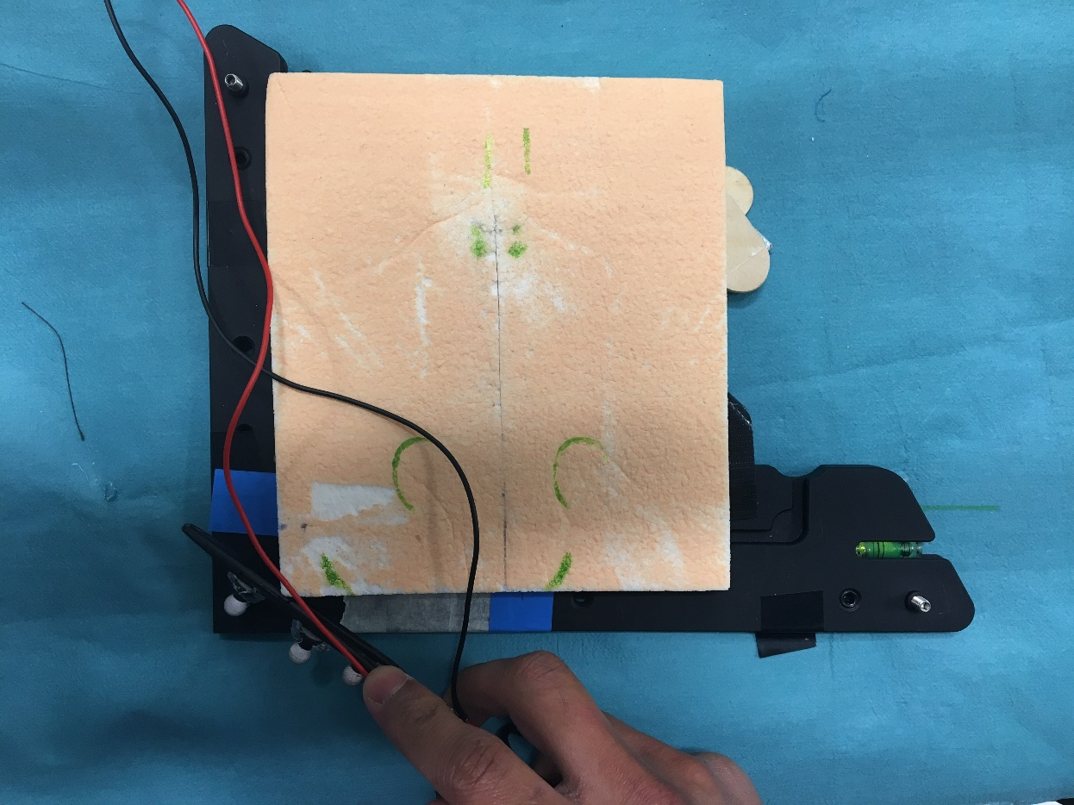
External validation
External validation for position
Manufacturer calibration
Known dimensions on the global frame
Compared with optical markers position
Results:
x error: 0.00117m
z error: 0.000525m

Slide 23
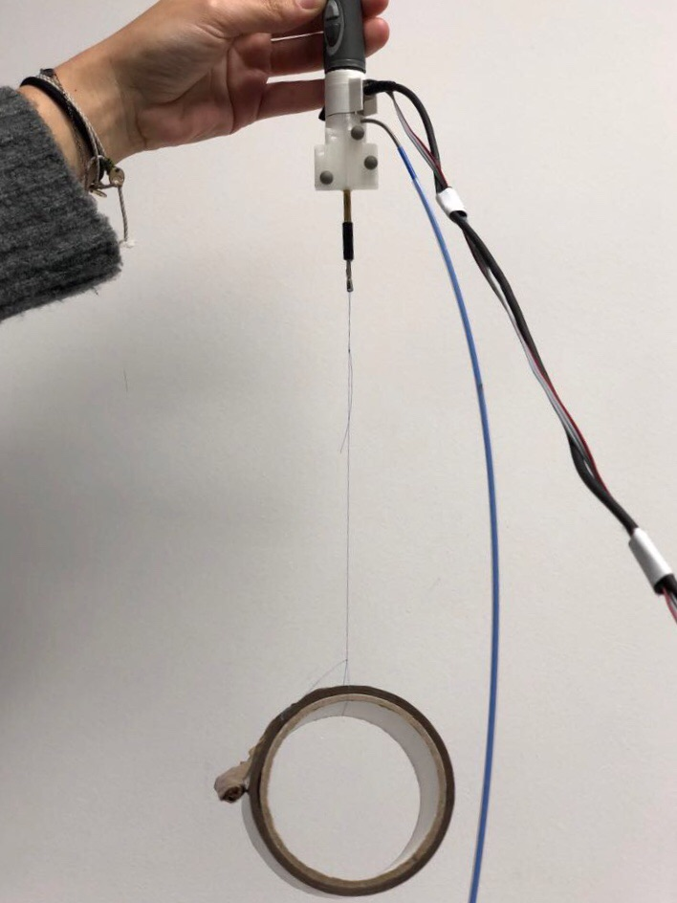
External validation
External validation for force
Manufacturer calibration
Measure the weight on scales
Measure force exerted on tool by gravity
Results:
error 0.006 N

Slide 24
Data & Optimisation

Slide 25
Data collected
1 clinician
10 datasets of 1 simple interrupted suture
2 excluded because of misregistration
Datasets contain end-tip tool position, orientation, force information and gripper state.
All sutures were high quality (no breaking when a force up to 10N was applied).
Notes:
1 clinician performing same task several times we have intravariablity neglected intervariabblitiy

Slide 26
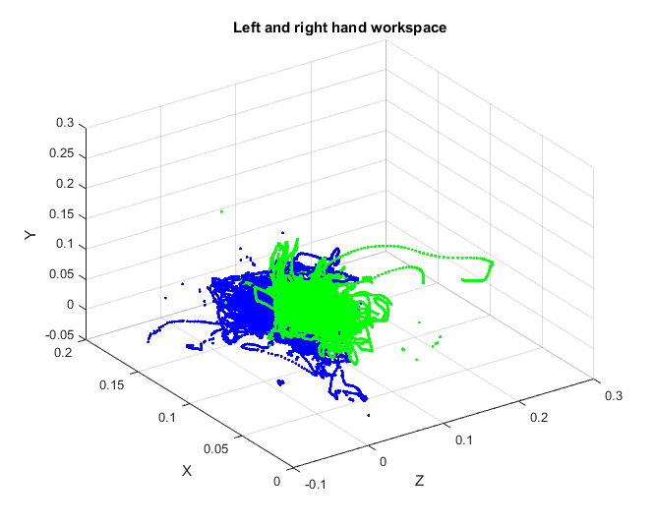
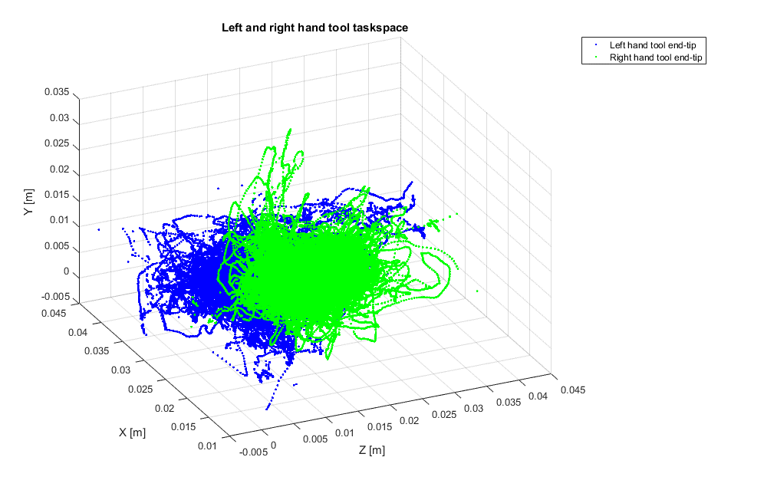
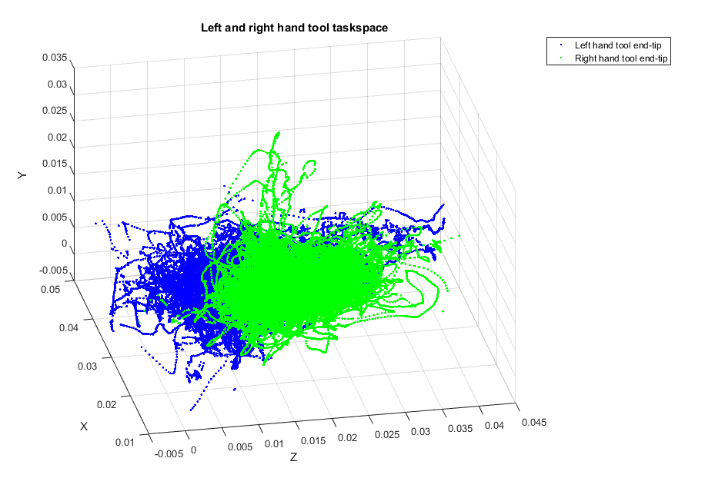
Data processing (I)
Task space:
Removal of outliers by defining task space boundaries
Scaling down by 4 to fit task space to scaffold dimensions
Before pre-processing
After pre-processing

Slide 27

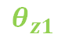

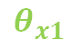
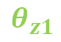
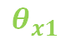
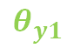

Data processing (II)
x
Tool rotation in each axis:
Find change of orientation of local tool frame across time by using two tool points.
$$θ_{x1}$$
$${}_{0}^{1}R$$
{1}
$$θ_{z1}$$
z
x
$$θ_{x1}$$
$$θ_{y1}$$
y
$$θ_{z1}$$
x
z
$${}_{1}^{0}R$$
$$θ_{y1}$$
z
y
{0}
y
$$t_{1}$$

Slide 28
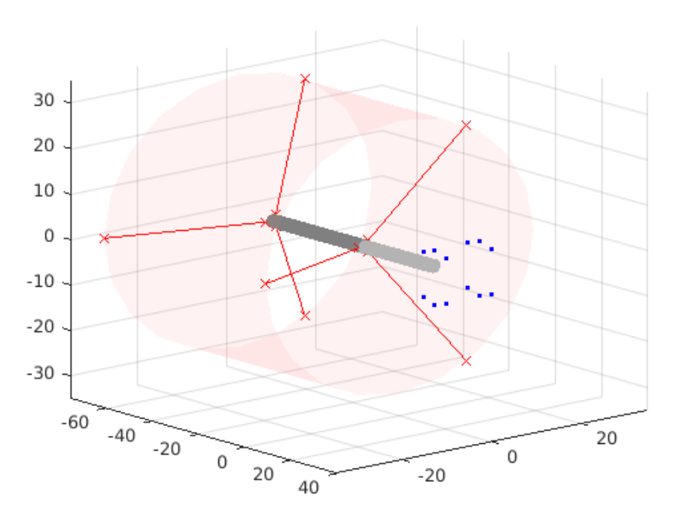
Data processing (III)
Minimum distance from first attachment point to end-tip:
Find maximum distance from end-tip of intersection tools points and set it as the minimal distance from first attachment points to end-tip.
x
Max d
z
Notes:
The reason we did this is to prevent the cables from interrupting when performing the ty. We found minimal distance to ensure no cable collision

Slide 29
Data processing (IV)
Force:
Computation of the average maximum force required to perform needle driving and tying.
Tying task identification was achieved by using the gripper state.

Slide 30
Results

Slide 31
Results
To avoid tool cable crossing:
Minimum distance from first attachment point to end-tip :
0.0204 m

Slide 32
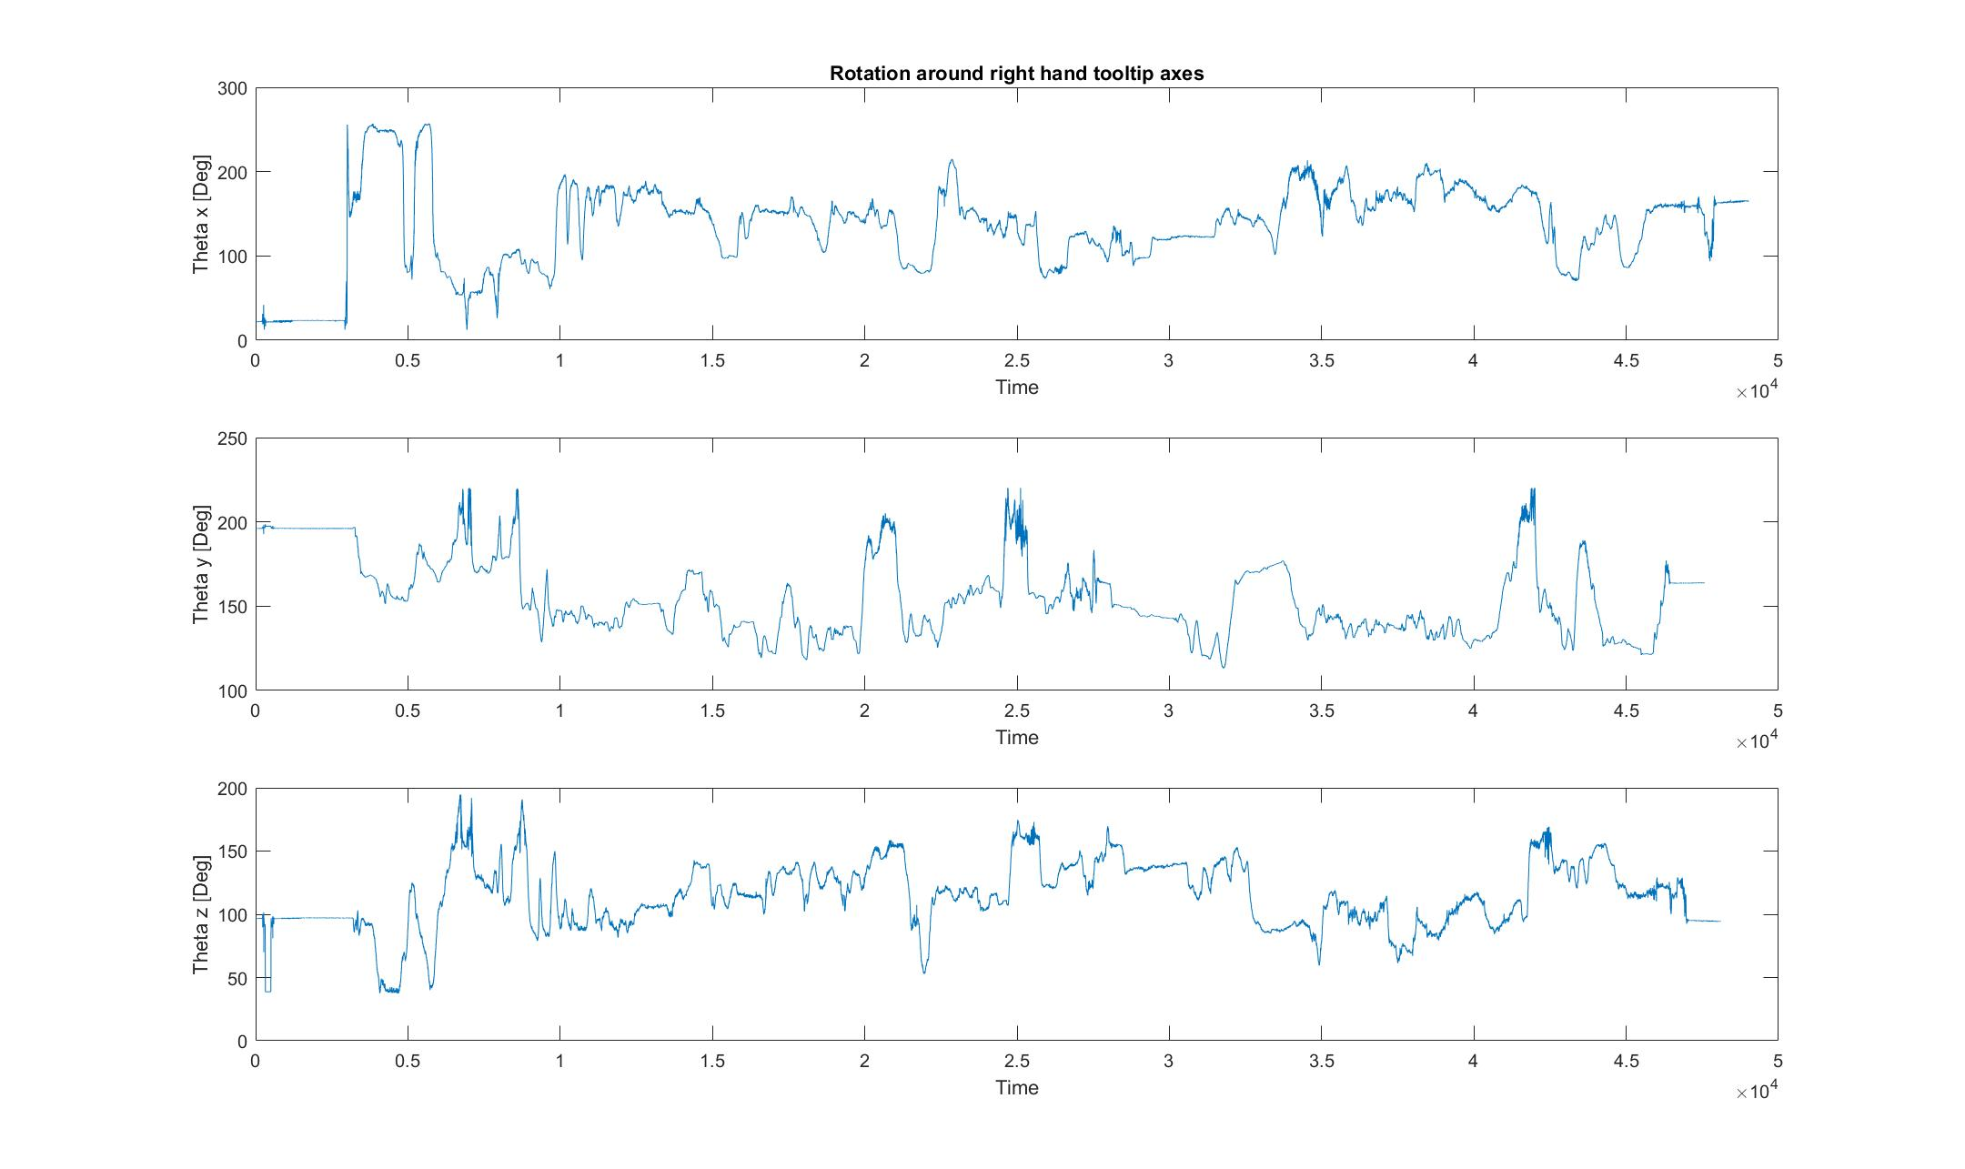
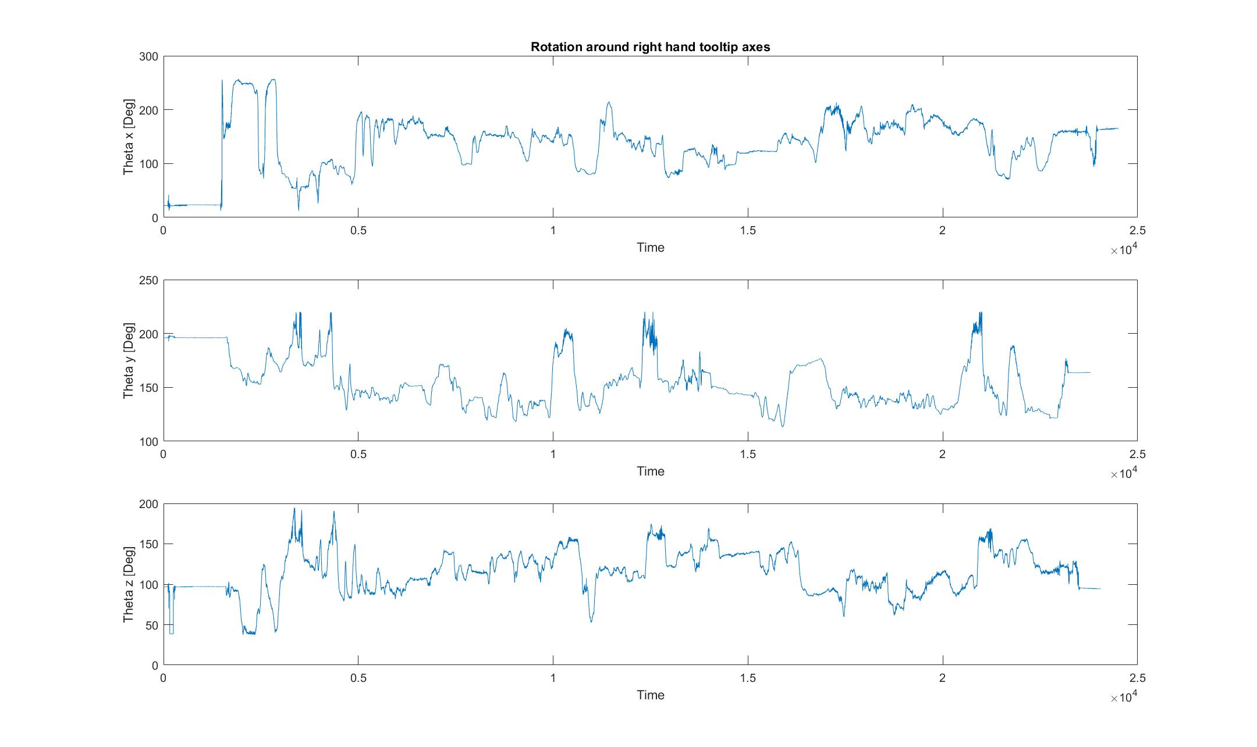
Results
Suture 1
For needle driving (right hand tool):
Average range of rotation required around x (roll):
227.519 degrees
Standard deviation:
28.757 degrees
Average range of rotation required around y( yaw):
108.621 degrees
Standard deviation:
24.120 degrees
Average range of rotation required around z( pitch):
145.247 degrees
Standard deviation:
24.715 degrees
Notes:
Standard deviation: 49.3722
Plots show that there is no generalibility, we cannot identify when we need this an

Slide 33
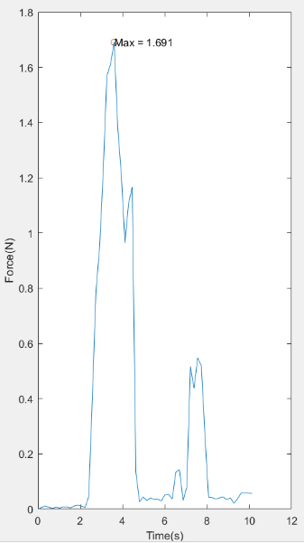
Results
Suture 1
For needle driving (right hand tool):
Average force required needle driving:
1.116 N
Standard deviation:
0.587 N
Notes:
No torque unfortunately
No measure of force in the end-tip
Standard deviation: 49.3722

Slide 34
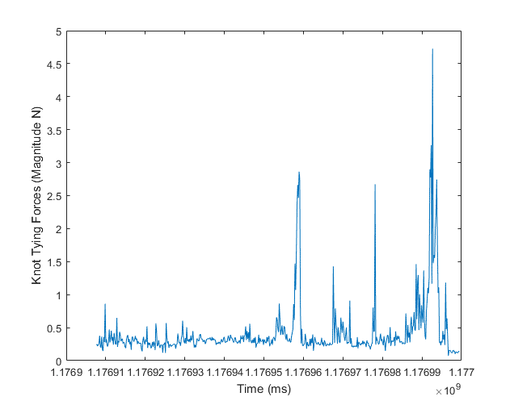
Results
Throw 3
Suture 1
For tying (both hand tools):
Range of maximum force required along datasets:
[1.4950, 14.3630] [N]
Average maximum force required:
6.2195 N
Standard deviation:
4.6437 N
Throw 1
Throw 2
Notes:
Last throw
Note large standard deviation but no suture broke so we can still use the minimum force among the max forces to

Slide 35
Optimisation
Optimisation algorithms
Pattern Search Particle Swarm Optimisation (PSwarm)
Particle Swarm Optimisation
Pattern Search
A random resampling step
Particle filter optimisation
Goals
Given a task-space and parameters, find the configuration of the tendons (i.e. angles, attachment points, feeding points and the length from tool tips to the origin of the overtube)

Slide 36
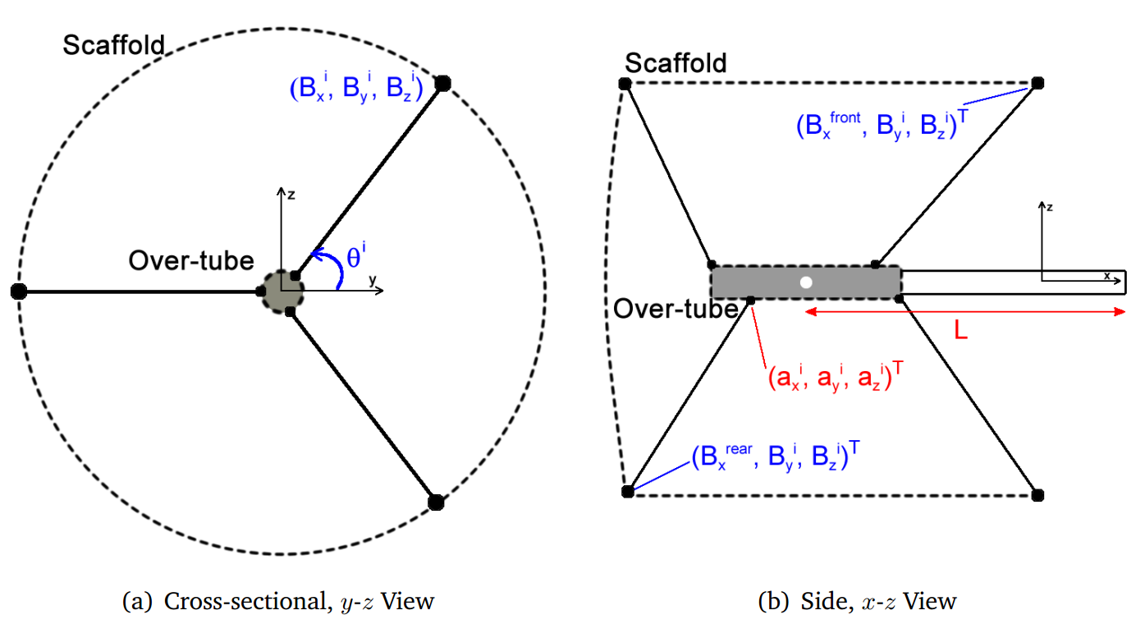
Optimisation

Slide 37
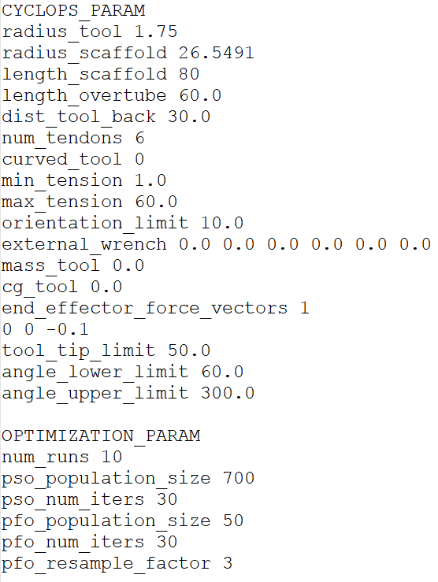
Optimisation - results
Outcome
No sign of convergence
Mesh size decreased in each iteration which means an optimal solution is not obtained
optimisation code stopped when maximum iterations reached

Slide 38
Problems encountered

Slide 39
Initial Tool Set-up
Intended use of 2 actuated endoscopic tools for both hands
Right-hand
Needle driver
Optical markers to track position data
Loadcell to track force and torque data
Left-hand
Tissue grasper
Optical markers to track position

Slide 40
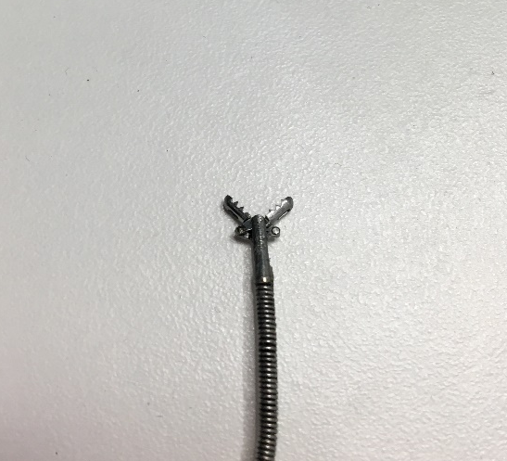
Right hand tool
Problems
Lack of force and friction
Needle rotation inside the grasper
Tool elasticity
Axial rotation

Slide 41
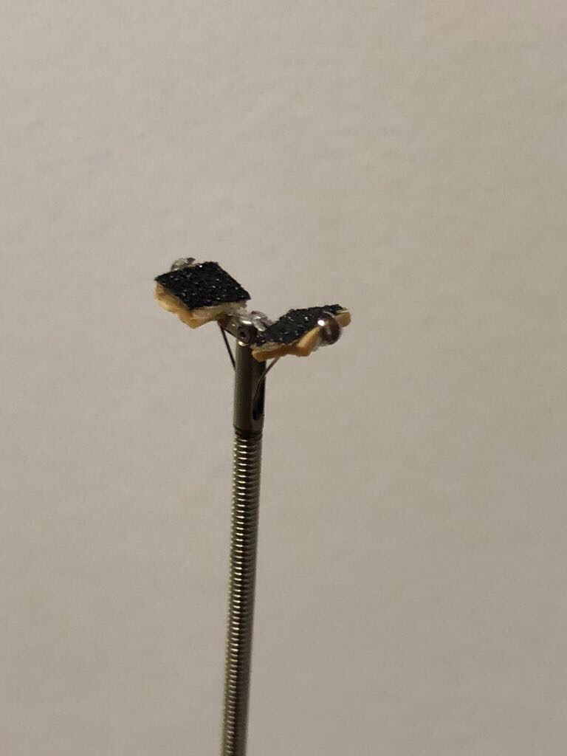
Methods Applied
Use of
Glue
Rubber
Sandpaper
Combination of the abovein the mouth of the grasper to try to eliminate needle rotation
Use of tape to minimize axial rotation

Slide 42
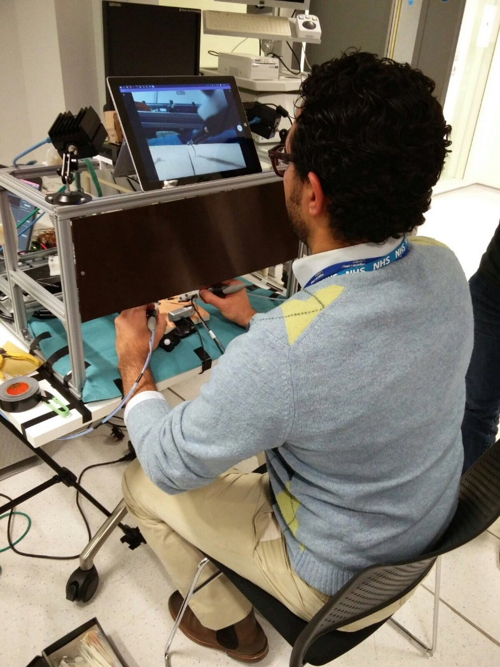
Testing the Tool
Test of each of the methods
Result:
Each iteration of right hand tool was unusable
Need of new needle driver
Data collection was delayed

Slide 43
Solution
No affordable endoscopic needle driver
No workshop materials available to prototype a needle driver system
Use of handheld needle driver for data collection

Slide 44
Aftermath
Loadcell was moved to left-hand tool
Not possible to simultaneously collect position data and force/torque data for needle driver
Need of breaking down the suturing task in 3 parts
Use of handheld needle driver instead of endoscopic needle driver
Different scale of right-hand and left-hand tools
Results needed to be scaled down

Slide 45
Discussion

Slide 46
Discussion
Limitations
Data collection
Intra surgeon vs inter surgeon variability
Errors from the Optitrack and calibration
Use of handheld needle driver instead of endoscopic needle driver
Misregistration of the rigid bodies due to artefacts
Load cell under the pad -> force through the pad instead of torque around axial rotation
Pad vs real tissue
Field of view of the webcam
Scaling of the raw task-space data
Notes:
F of view covered the entire pad
Scale – it was one option over thousands of them. Implications: forces, maybe unrealisitic data. Future work: retake data but we had a limitation that we used a huge needle holder as grasper which is very big.
time limitation

Slide 47
Discussion
Optimisation
not converging for the input parameters and task-space data
Task-space is not fully reachable with the input parameters
Time constraints
Tweaking population and iterations parameters

Slide 48
Conclusions

Slide 49
General Requirements
Current CYCLOPS has 5 DoF → need to implement the 6th DoF for suturing task
Develop an endoscopic needle driver
Solve the axial rotation and translation of the endoscopic instruments within overtubes

Slide 50
Engineering Requirements for Suturing CYCLOPS
Needle Driving (6th DoF Roll)
Mean of Max Force (STD) | 1.116N (0.587N)
Mean of Axial Rotation Range (STD) | 227.519˚ (28.757˚)
Mean of Max Axial Angular Velocity (STD) | 484.113˚ (44.827˚) [Deg/s]
Axial Torque | ----------------------------
Tying a knot
Force required for tying (range) | [1.4950, 14.3630] [N]
Min tool protrusion required | 0.0204m

Slide 51
Group Dynamics
NAME | BACKGROUND | TASKS
Siddharth Agarwal | Medicine, Medical Imaging | Data collection, data analysis
Hyunggi Chang | Manufacturing engineering | Hardware, data collection
Laura Ros Freixedes | Biomedical engineering | Data analysis
Chara Giannoudi | Electrical engineering | Hardware
Ya-Yen Tsai | Bioengineering, Mechatronics | Hardware, Data analysis
Shared workload was ensured by working together in the lab regardless of our task
Gained skills from different backgrounds by working with each other
Time management
Communication
Organisation

Slide 52
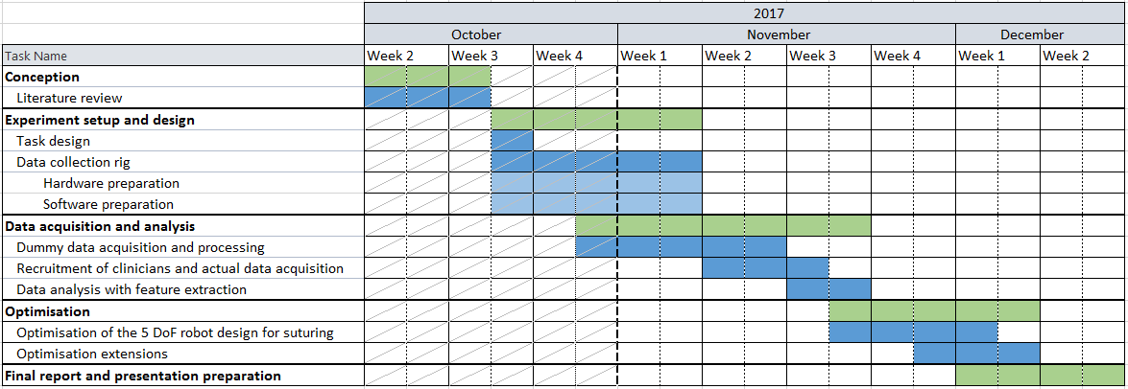
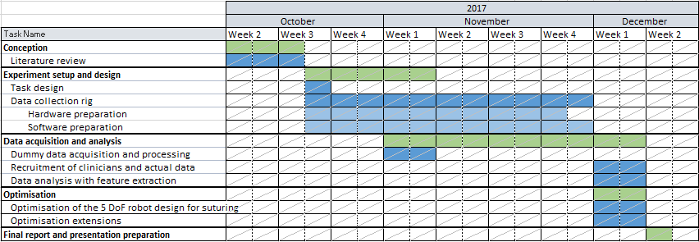
Project Plan & Project Progress
Project plan
Project progress

Slide 53
Thank you

Slide 54
Questions?

